Slide 1
Can we predict depression in students? A machine learning approach
Sneha Sivakaran I Module 12 - UMIT Tirol I 12th June 2026

Slide 2
Table of contents
01
02
03
04
Research Question & Dataset
Preprocessing & EDA
Kaggle dataset, 503 entries, 11 features
Cleaning, encoding, Spearman correlation
Modelling & Evaluation
Ethics & Conclusions
Logistic Regression VS. Random Forest
Bias, EU AI Act, key findings

Slide 3
Research Question & Dataset
Research Question
Dataset
Source: Kaggle- Student Depression Dataset
Entries: 503
Features: 11
Target: Depression (Yes / No)
Methods: Logistic Regression & Random Forest
Can lifestyle and academic factors such as sleep duration, academic pressure and financial stress be used to predict depression in university students?

Slide 4
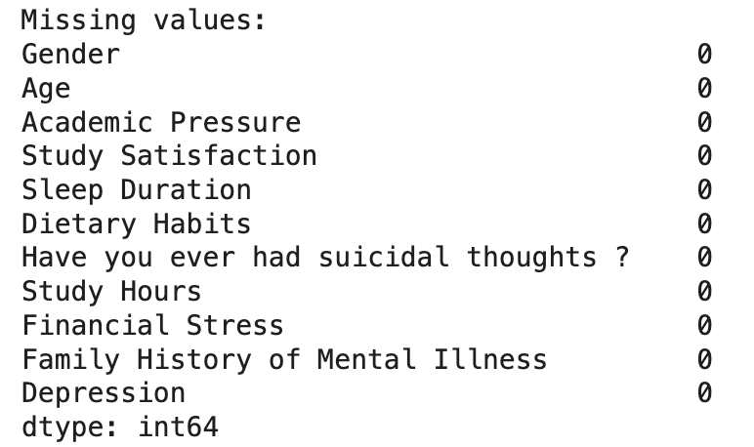
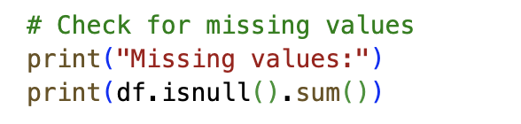
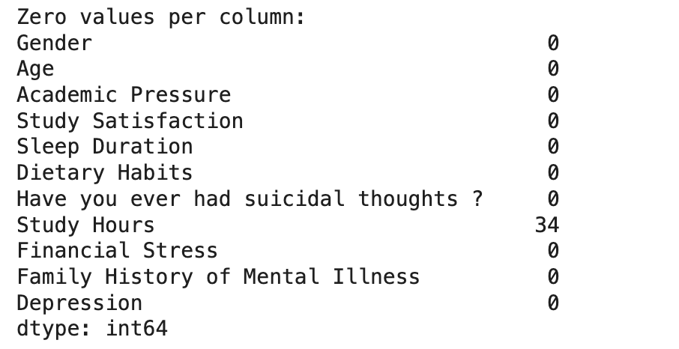
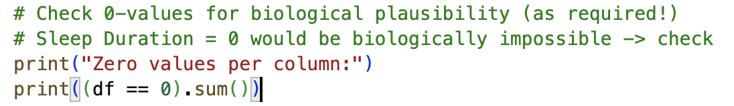
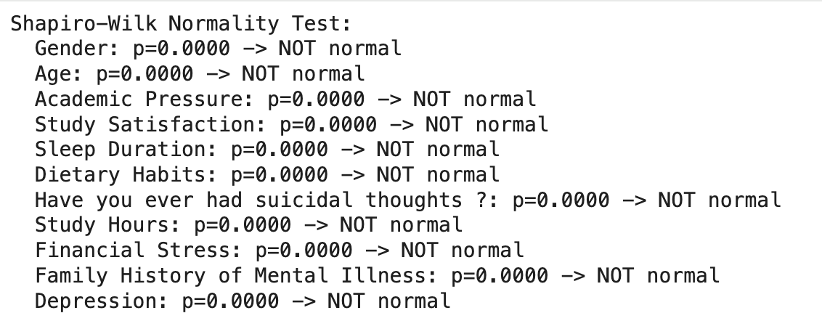
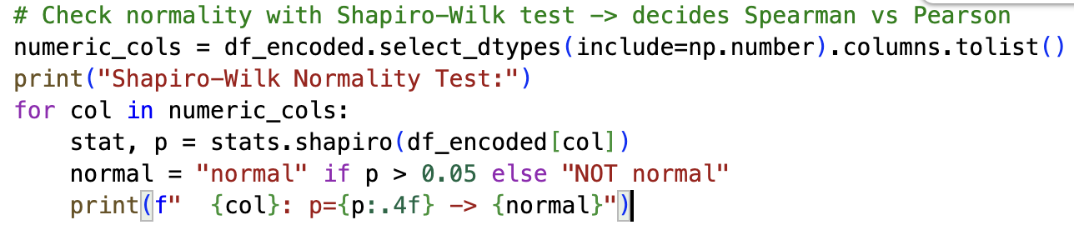
Preprocessing & EDA

Slide 5
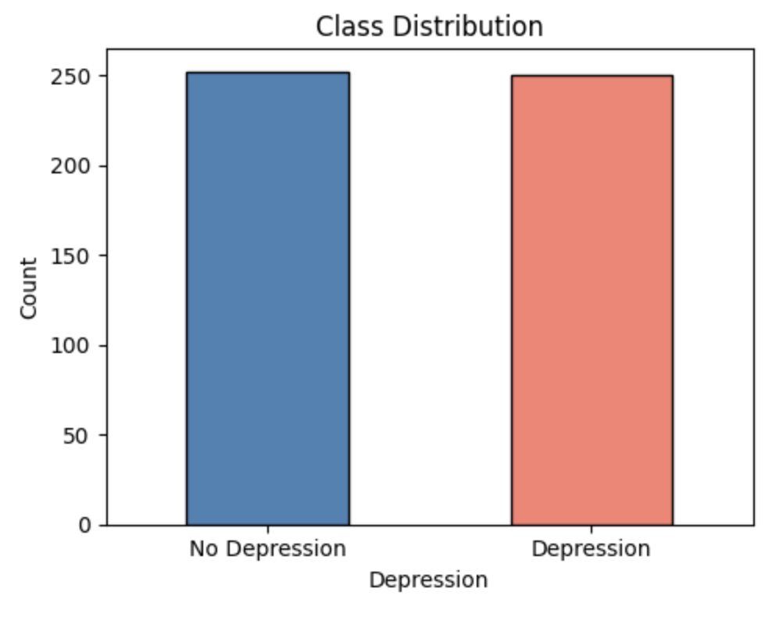
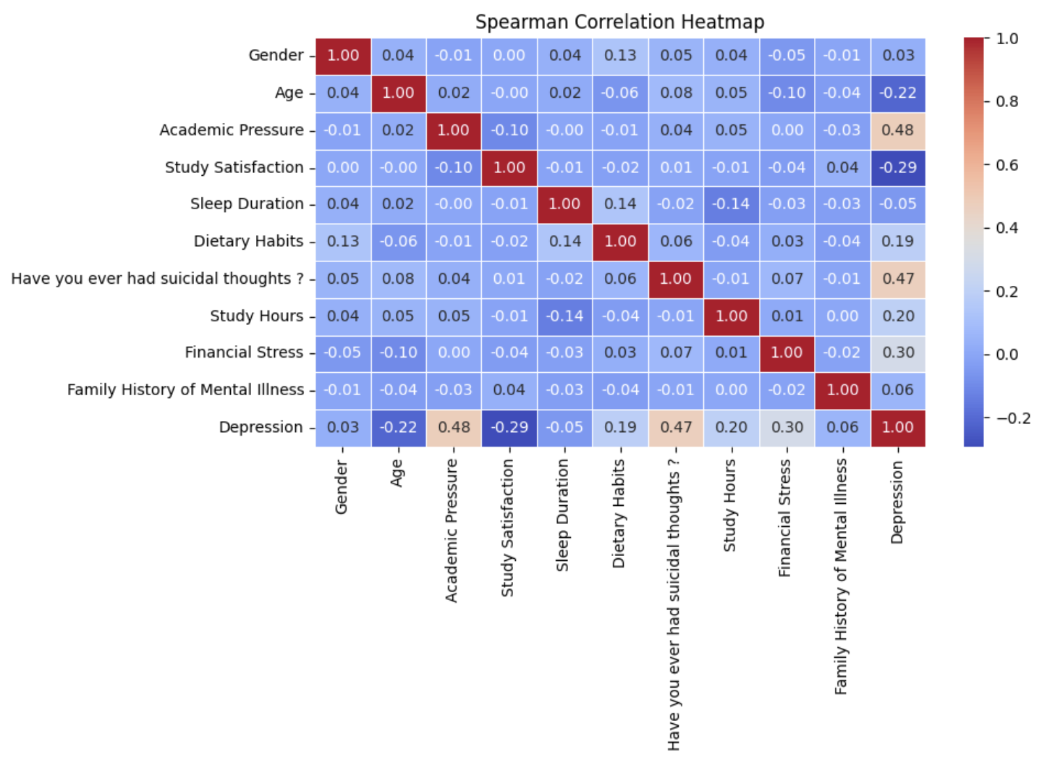
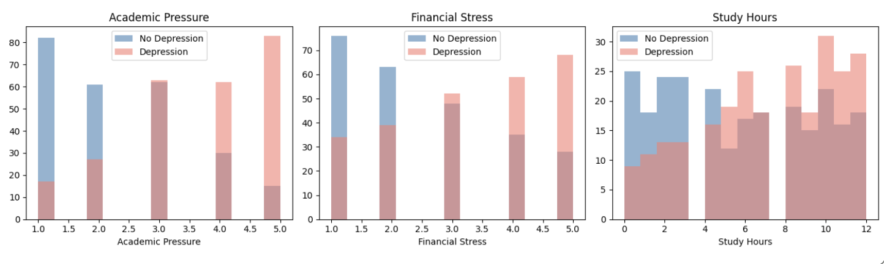
Preprocessing & EDA

Slide 6
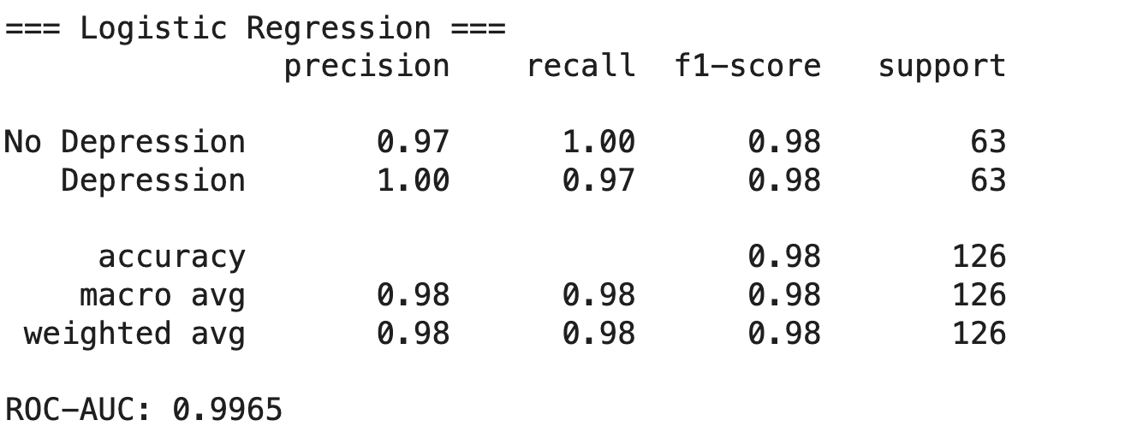
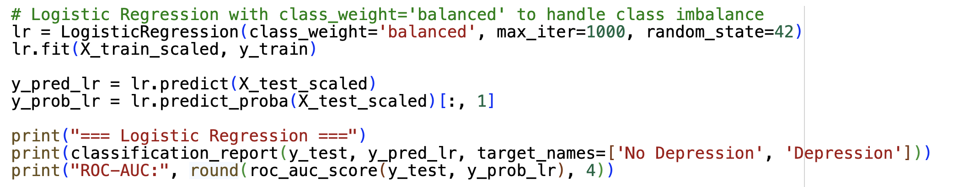
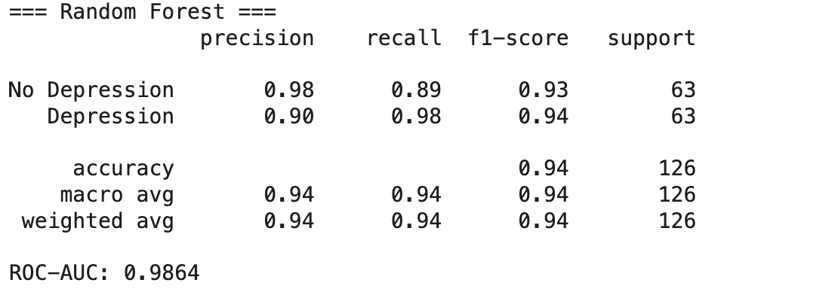
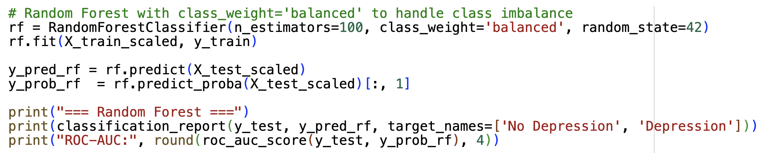
Modelling & Evaluation

Slide 7
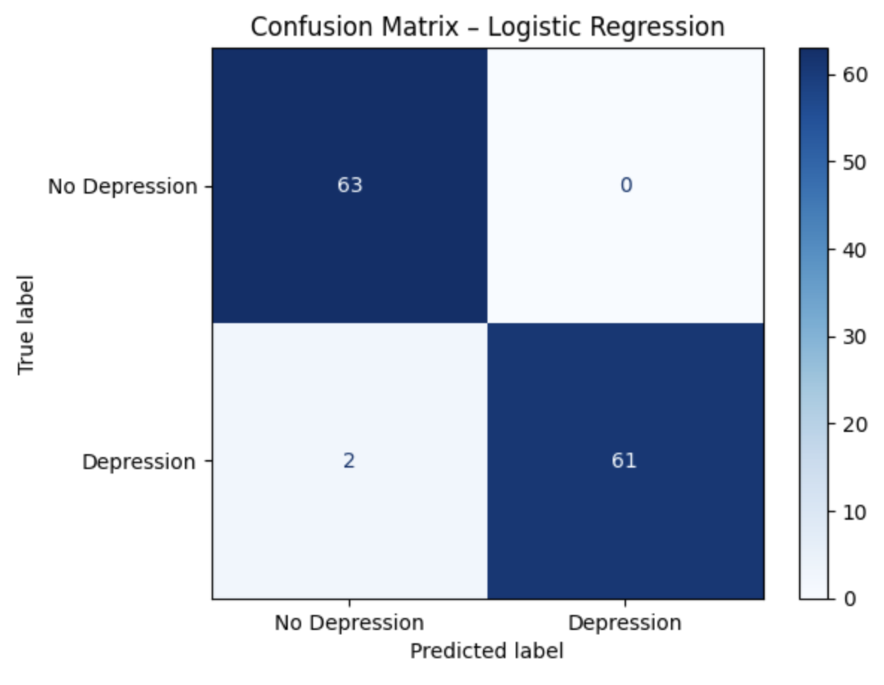
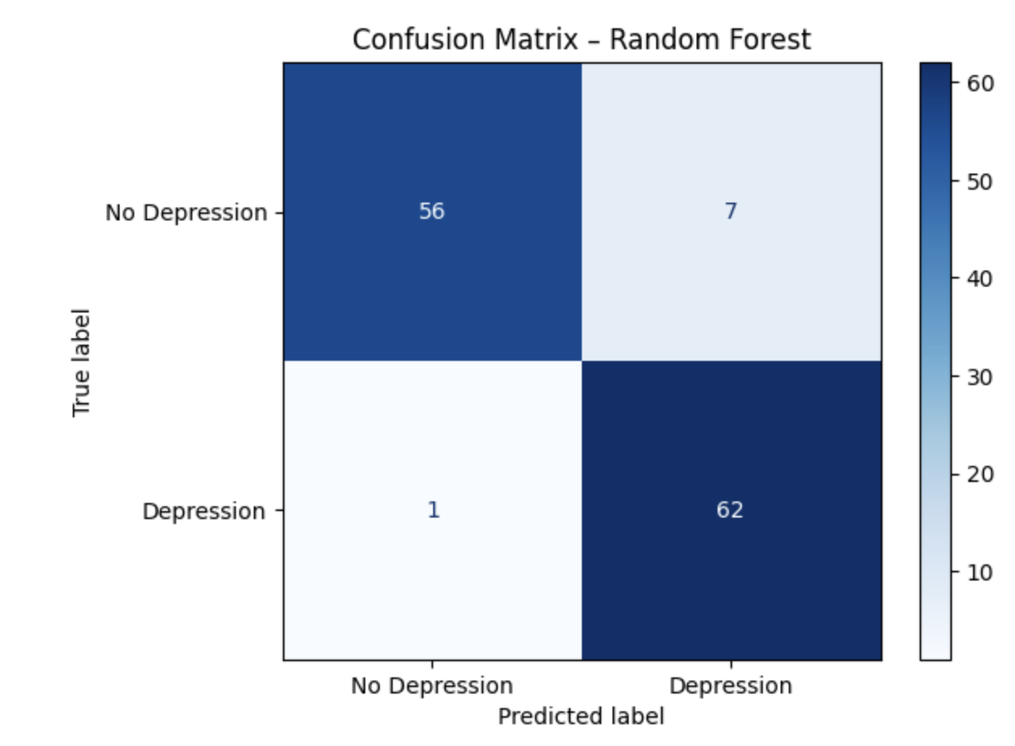
Modelling & Evaluation

Slide 8
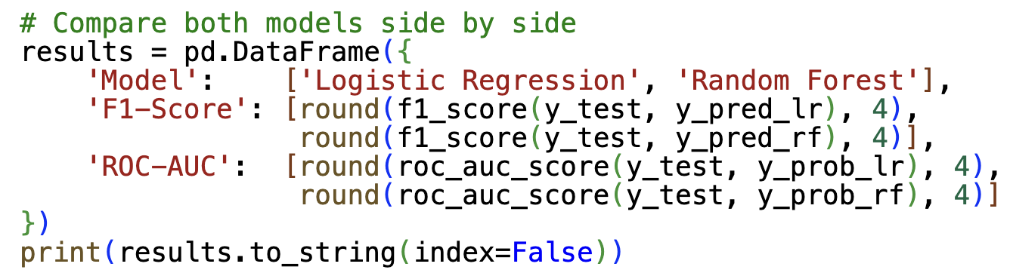
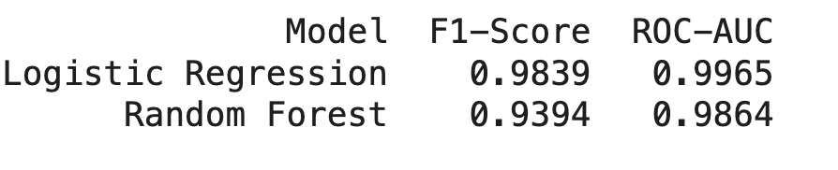
Model Comparison

Slide 9
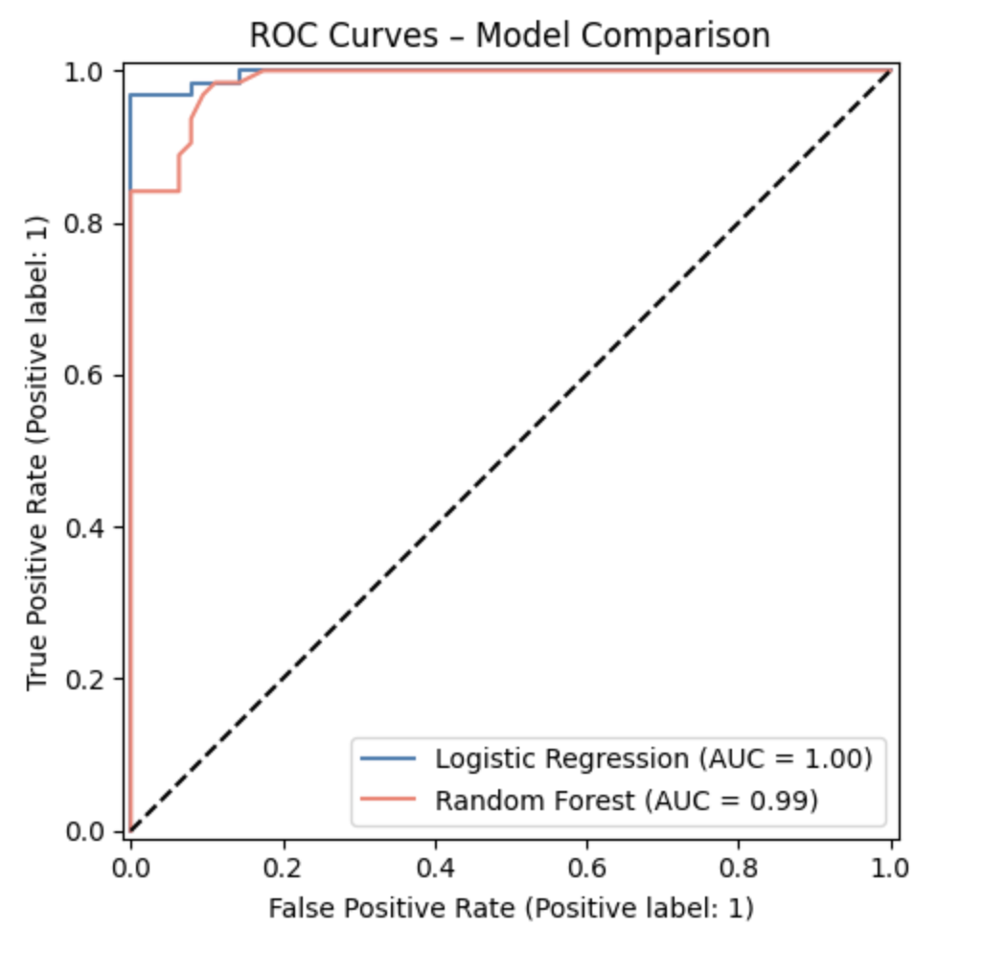
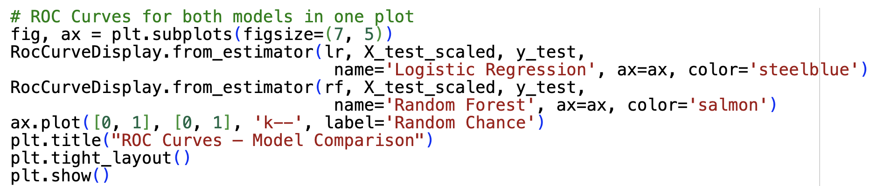
ROC Curves

Slide 10
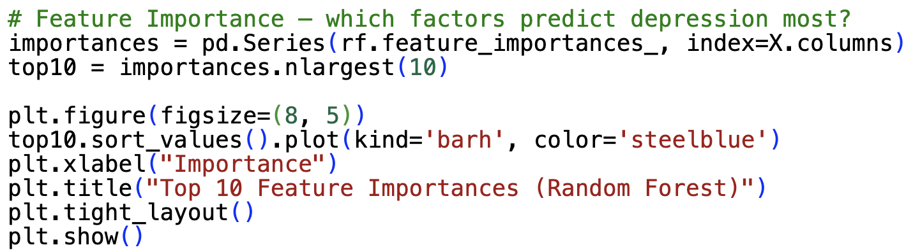
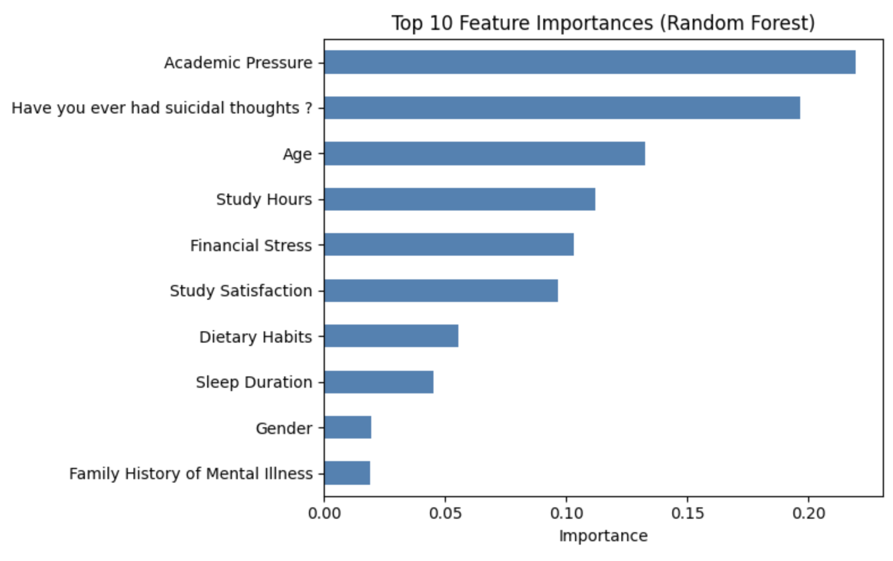
Feature Importance

Slide 11
Ethics & Bias
Data Bias
Algorithmic Bias
Only university students
Not generalisable to other populations
(working adults, different cultures, school children)
📊
⚖️
Underrepresented subgroups (age, gender)
Model may perform worse for minority groups
No demographic fairness testing done
Sensitive Data
False Predictions
Mental health = highly sensitive data
GDPR compliance required
Informed consent mandatory
🔒
⚠️
False Negative → depressed student goes undetected
False Positive → student flagged incorrectly, wastes resources

Slide 12
EU AI Act How does this system fit in?
High- Risk AI System
Mental health prediction
Classified under EU AI Act
🔴
📋
High-Risk Category
Transparency
Annex III: health & education Strict requirements apply
Decisions must be explainable
Results must be documented
👁️
🚫
⚖️
Human Oversight
No Autonomous Decisions
Accountability
Counsellor/doctor reviews output
No fully automated decisions
Screening tool only
Never sole basis for diagnosis
Developer & deployer responsible
Legal liability applies

Slide 13
Conclusion
"Can lifestyle and academic factors predict depression in university students?"
➝ Yes, they can!
Academic Pressure, Financial Stress & Sleep
Duration are the strongest predictors
Logistic Regression: 98% accuracy, ROC-AUC 0.9965 → best overall model
Random Forest: slightly lower but strong, only 1 False Negative
Early ML-based detection could enable targeted student support programmes
Ethical deployment requires human oversight & data protection

Slide 14
Resources
Eissler, C., Sailer, M., Walter, S. & Jerg-Bretzke, L. (2019). Psychische Gesundheit und Belastung bei Studierenden. Prävention und Gesundheitsförderung, 15(3), 242–249. https://doi.org/10.1007/s11553-019-00746-z
Mofatteh, M. (2020). Risk factors associated with stress, anxiety, and depression among university undergraduate students. AIMS Public Health, 8(1), 36–65. https://doi.org/10.3934/publichealth.2021004
Weber, R. (2024, 26. Februar). Wie belastet sind Studierende? Forschung & Lehre. https://www.forschung-und-lehre.de/zeitfragen/wie-belastet-sind-studierende-6268

Slide 15
Thank you for your attention!

